Slide 1

Employee Payroll Management
“Desktop Application for Payroll Automation”
Sarth Thakar – IT049
Vishal Parmar – IT061

Slide 2
Introduction
Why payroll management is important?
Payroll ensures accurate and timely salary payments to employees. It also improves employee satisfaction and reduces financial errors.
Problems with Manual Payroll Systems
Manual systems are time-consuming, error-prone, and hard to track. They also lack proper data security and record tracking.
Objective of Project
To automate salary calculation and record management using Python. The system aims to improve accuracy, speed, and data security in payroll.

Slide 3
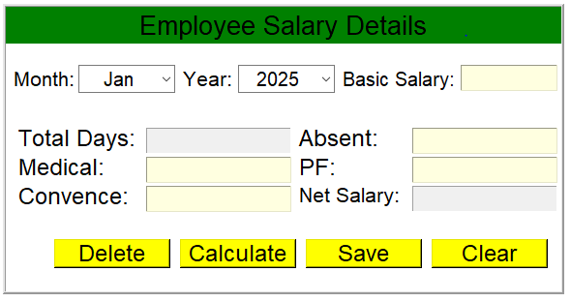
Project Objectives
Automating salary calculation.
Easy retrieval and management of payroll data.
The system automates salary calculation to reduce errors and save time. It securely allows easy retrieval for efficient payroll management.

Slide 4
Database Design
The Employee Payroll Management System uses a single SQLite database named emp.db with a main table called e_salary. This table stores both employee personal information and salary details. Each employee is uniquely identified by the Employee Code, which serves as the primary key. Other personal details include Name, Designation, Age, Gender, Email, Hiring Location, Date of Birth, Date of Joining, Proof ID type, Contact Number, Employment Status, Years of Experience, and Address.
Salary-related fields include Month, Year, Basic Salary, Total Days, Absent Days, Medical Deduction, Provident Fund Deduction (PF), Conveyance Allowance, and the Net Salary, which is calculated based on the attendance and deductions. Additionally, a field called receipt_file stores the path to the employee’s salary receipt text file saved externally in the salary_receipts folder.

Slide 5
System Features
Graphical User Interface (GUI):- Built using Tkinter (Python GUI library), Interactive and user-friendly design, Divided into structured frames: Employee Details Section,Salary Details Section,Calculator Section, Salary Receipt Section.
Employee Management:- Add, Search, Update, Delete employee records.
Salary Calculation System:- Auto-calculates Net Salary based on:Basic Salary, Total Days / Absent Days,Medical Deduction,PF (Provident Fund), Deduction, Conveyance Allowance.
Automated Date and Age Handling:- Uses tkcalendar.DateEntry for easy date selection, Automatically calculates Age from DOB, Restricts joining date — ensures employee is at least 21 years old, Updates maximum experience based on age.
Search and Display Functionality:- Search employee data by Employee Code, Fetches & displays complete record.
Database Integration (SQLite):- Stores and retrieves all employee salary, Prevents duplicate Employee Codes.
Salary Receipt Generation:- Automatically generates Salary Slip, Supports saving receipts as text files, Provides a Print button.
Built-in Calculator:- Integrated functional calculator for quick payroll math.
Input Validation & Error Handling:- Validates:Email format, Numeric Employee Code and Contact Number, Proper date , Experience and age relation, Displays error messages.
Data Utility Features:- Clear Button, Delete Button, Update Button, Save Button.
Dynamic Interface Feedback:- Buttons are dynamic, Scrollable salary receipt, Real-time calculated results.
Additional Utilities:- Displays total days, Shows current date on salary slip, Custom footer.

Slide 6
System Architecture
Login
Dashboard
Add/Update Employee
Calculate Salary
Generate Receipt
Save to Database
Print/Export

Slide 7
Advantages
Time-saving and efficient.
Secure and reliable.
Easy data retrieval.
Accurate salary computation.
Simple and user-friendly interface.

Slide 8
Limitations & Future Enhancements
Limitations:
Single-user access.
No online (cloud) connectivity.
Future Enhancements:
Add multi-user login with roles (Admin, HR).
Integrate email payslip sending.
Generate analytical reports (salary trends).
Cloud-based database integration.

Slide 9
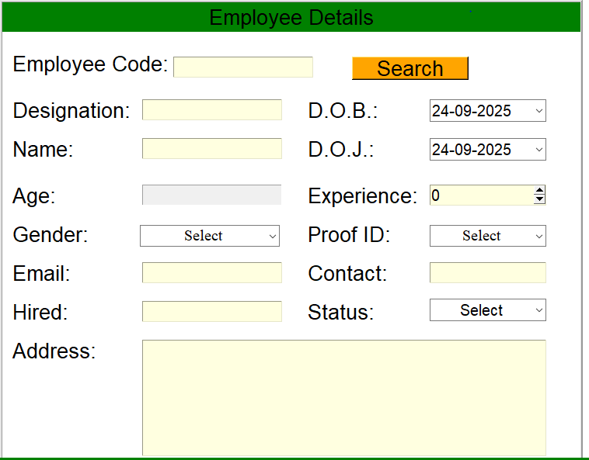
Screenshots / Demo
Employee Frame

Slide 10
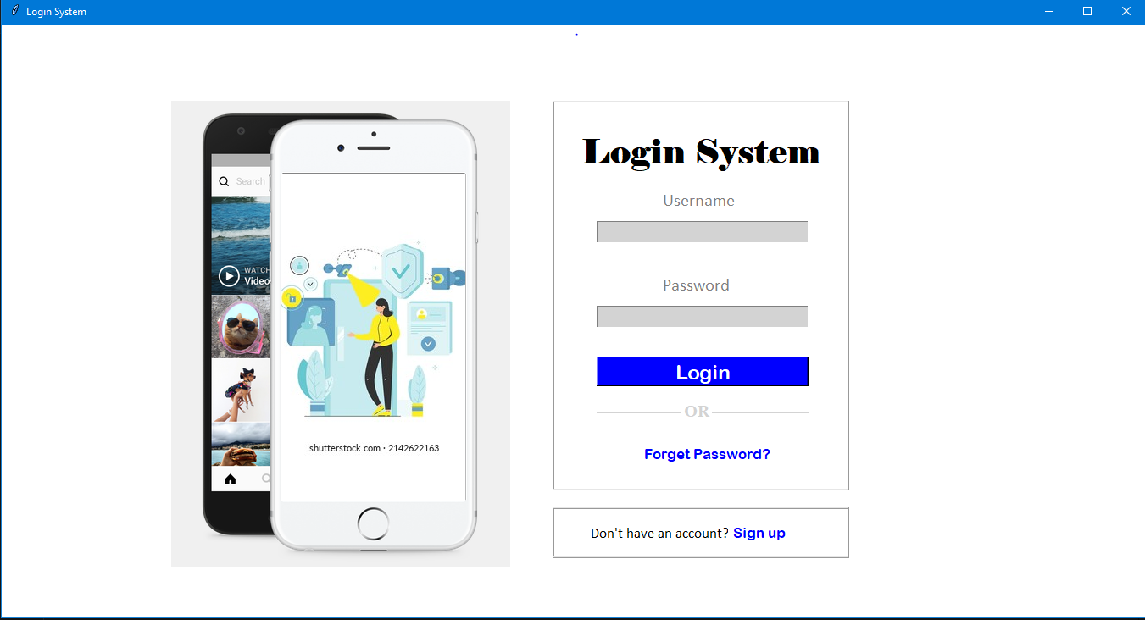
Login

Slide 11
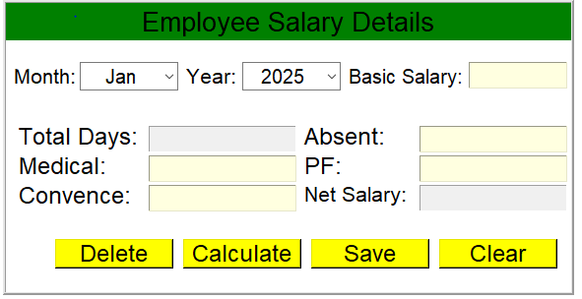
Screenshots / Demo
Employee Salary Frame

Slide 12
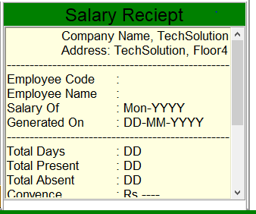
Screenshots / Demo
Salary Receipt Frame

Slide 13
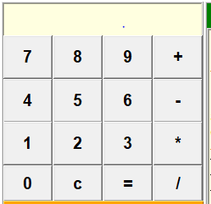
Screenshots / Demo
Calculator Frame

Slide 14
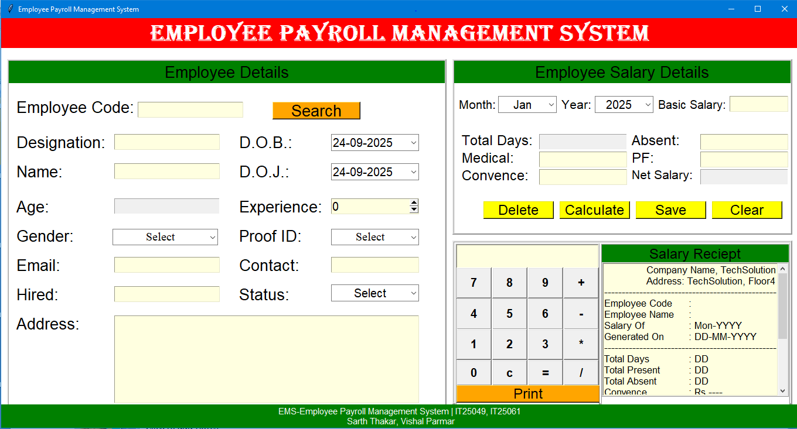
Screenshots / Demo
Main Frame

Slide 15
Challenges Faced
Handling database connection:
Connections left open or not committed, data loss, DB locks.
Race conditions (two operations try to write at the same time).
Wrong file paths (saved files not found because saved them in a folder but later looked in the root).
Missing schema/constraints, duplicates (e.g., duplicate emp_code) and data inconsistencies.
Tkinter form validation:
Validation logic scattered across multiple functions, inconsistent UX.
Using message boxes for every minor errors.
Inputs (combo boxes) created with the wrong parent cause layout/behavior issues.
Debugging errors:
Errors hidden by broad except: blocks, leading to "silent failures".
Hard-to-reproduce bugs because logging is missing.
Edge cases (zero division, empty strings, unexpected types) cause crashes.

Slide 16
Conclusion
The Employee Payroll Management System simplifies the payroll process.
Reduces manual workload and improves efficiency.
Demonstrates effective use of Python with database integration.

Slide 17
Learnings
Hands-on experience with GUI programming using Tkinter.
Understanding database connectivity in Python.
Improved debugging and system design skills.
Learned about modular programming and error handling.

Slide 18
Thank You

